Slide 1
Unit 4: For Live Session Assignment
Alternatives to the t-tools!

Slide 2
Part 1

Slide 3
Quick Quiz Questions

Slide 4
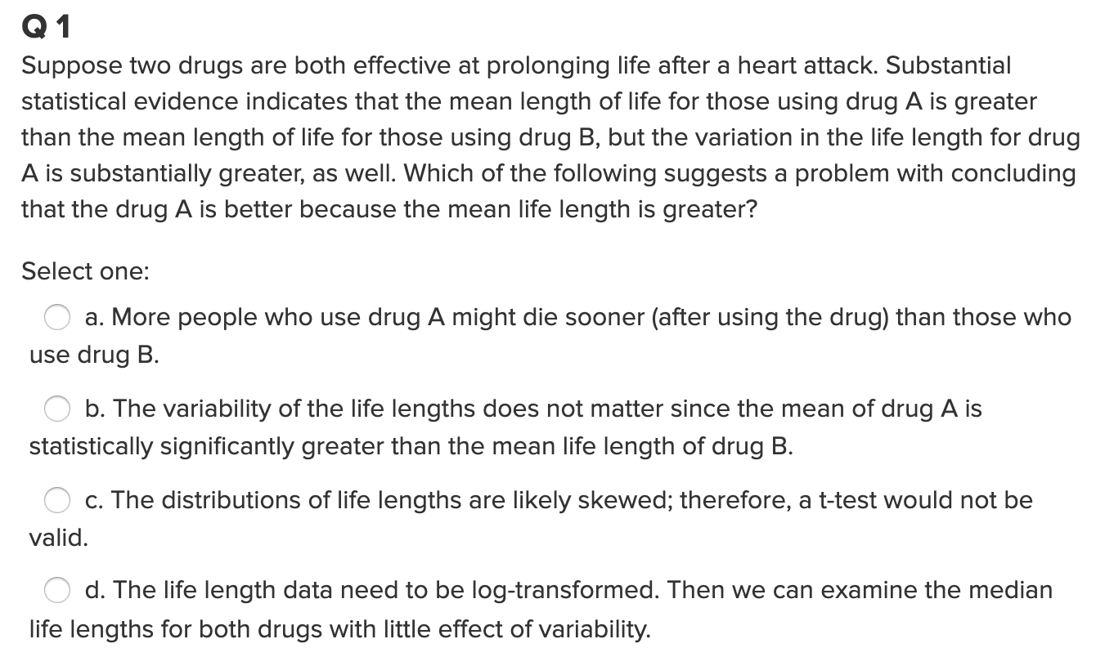
Question 1

Slide 5
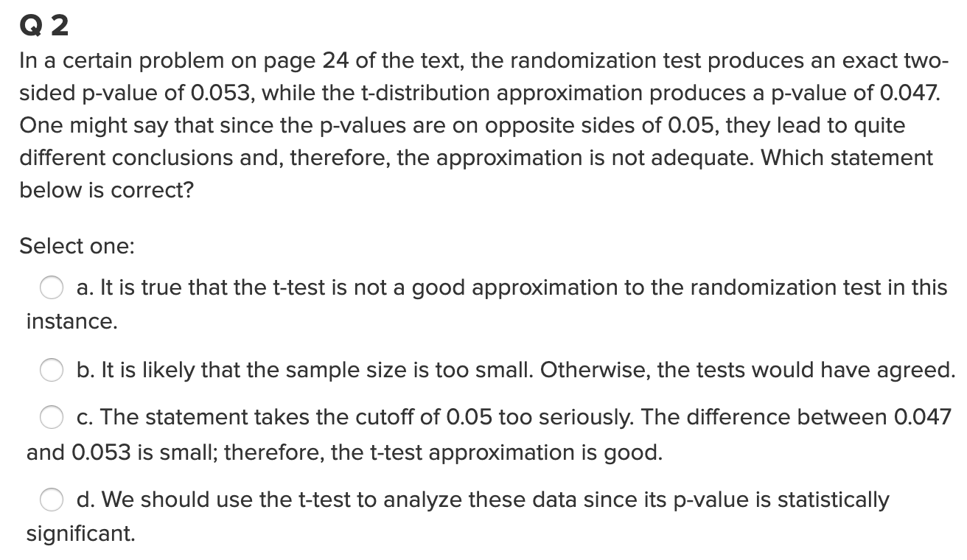
Question 2

Slide 6
End Part 1

Slide 7
Part 2

Slide 8
Question 1 (2 hours)
IBM gives each employee in the marketing department technical training
Based on further testing, it appears the traditional training method isn’t effective
Hence, a new training method is developed
Below are the test scores of 4 individuals who just finished the “New Method” and the last 3 test scores from employees trained via the “Traditional Method” course
Is there evidence to suggest that the “New Method” increases test scores?
A) Address the assumption of a t-test to answer this question.
Perform the test you feel is appropriate given the methods you have learned thus far.
As a reminder: Please clearly address this problem with slides that you will present in breakout and submit those slides to 2DS before live session (preferably 24 hours before.)
New Method | Traditional Method
37 | 23
49 | 31
55 | 46
77

Slide 9
Question 1 Solution: T-test Assumptions
The assumption for the test is that both groups are sampled from normal distributions.
Equal variances
The variances do not appear to be equal between the groups.
An alternative to the t-test must be used.
Wilcox Rank Sum or Sign Test

Slide 10
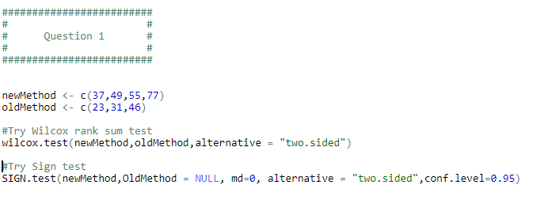
Question 1 Solution: (R Code)

Slide 11
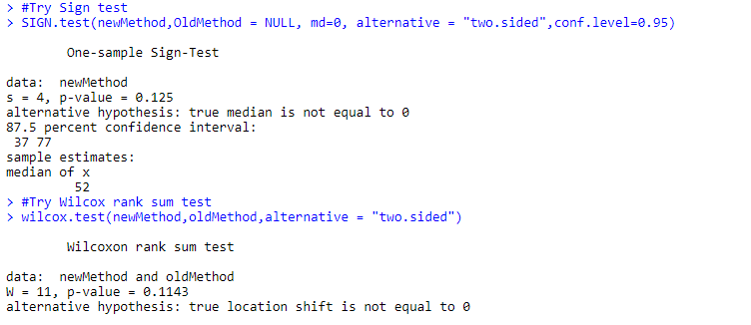
Question 1 Solution: R output

Slide 12
Question 1 Solution: Conclusions
T-Test Conclusions
Step 1: H_0 Mu_new_test = Mu_old_test
Step 2: H_a Mu_new_test != Mu_old_test
Step 3: Test statistic = 1.9679
Step 4: P-value = 0.1062
Step 5: FTR H_0!
Step 6: We will fail to reject H_0 and conclude that there is insufficient evidence supporting the claim that there is a difference between the two groups
Wilcox Rank Sum Conclusions
P-Value: 0.1143
Conclusion: Fail to Reject H_0 and conclude there is insufficient evidence supporting the claim that there is a difference between the two groups
Sign Test Conclusions
P-Value: 0.125
Conclusion: Fail to Reject H_0 and conclude there is insufficient evidence supporting the claim that there is a difference between the two groups

Slide 13
Question 1 Solution: Takeaways
Multiple tests were performed
Each test yielded the same conclusion
Two-sample T-test, Wilcox rank sum, and Sign test
P-Values were roughly similar (0.125,0.1143,0.1062)
Can safely conclude, there is insufficient evidence to conclude the groups are different. Meaning, the training methods need more evaluation to determine a difference.

Slide 14
Review the Two Examples in Order to Answer Question 2

Slide 15
Welch’s t-Test

Slide 16
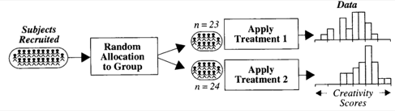


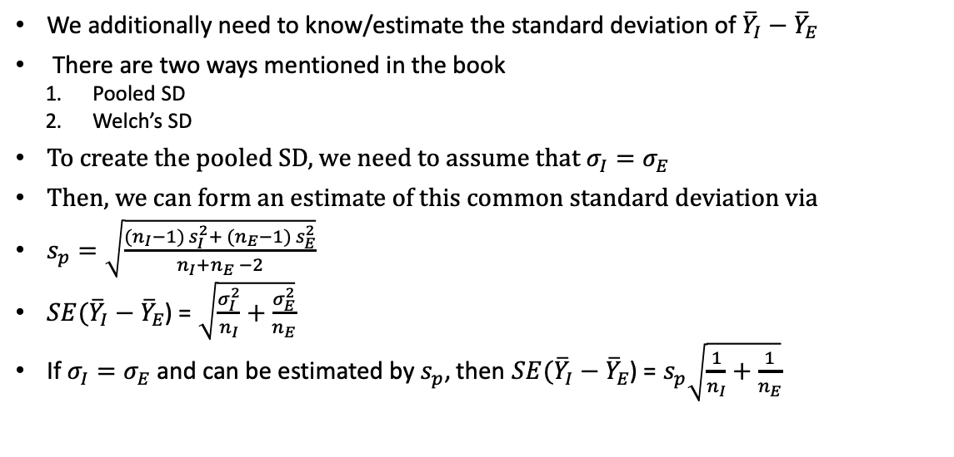


Creativity Study: Reminder
$→$ Population mean: $μ_{I}$
I
$→$ Population sd: $σ_{I}$
$→$ Population mean: $μ_{E}$
E
$→$ Population sd: $σ_{E}$
We additionally need to know/estimate the standard deviation of ${\overline{Y}}_{I}−{\overline{Y}}_{E}$
There are two ways mentioned in the book
Pooled SD
Welch’s SD
To create the pooled SD, we need to assume that $σ_{I}=σ_{E}$
Then, we can form an estimate of this common standard deviation via
$s_{p}=\sqrt{\frac{({n_{I}−1) s}_{I}^{2}+ ({n_{E}−1) s}_{E}^{2}}{n_{I}+n_{E} −2}}$
$SE({\overline{Y}}_{I}−{\overline{Y}}_{E}$) = $\sqrt{\frac{σ_{I}^{2}}{n_{I}}+\frac{σ_{E}^{2}}{n_{E}}}$
If $σ_{I}=σ_{E}$ and can be estimated by $s_{p}$, then $SE({\overline{Y}}_{I}−{\overline{Y}}_{E}$) = $s_{p}\sqrt{\frac{1}{n_{I}}+\frac{1}{n_{E}}}$
What if this assumption isn’t true?

Slide 17

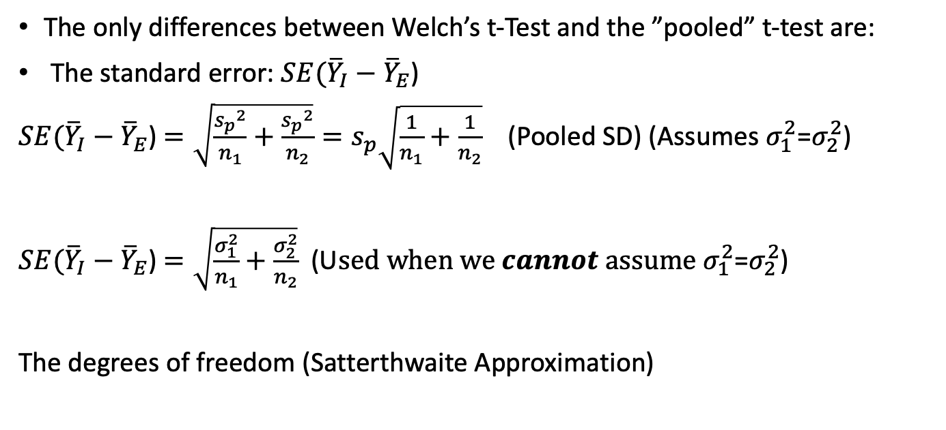
Welch’s t-Test
The only differences between Welch’s t-Test and the ”pooled” t-test are:
The standard error: $SE({\overline{Y}}_{I}−{\overline{Y}}_{E}$)
$SE({\overline{Y}}_{I}−{\overline{Y}}_{E}$) $=\sqrt{\frac{{s_{p}}^{2}}{n_{1}}+\frac{{s_{p}}^{2}}{n_{2}}}=s_{p}\sqrt{\frac{1}{n_{1}}+\frac{1}{n_{2}}}$ (Pooled SD) (Assumes $σ_{1}^{2}$=$σ_{2}^{2}$)
$SE({\overline{Y}}_{I}−{\overline{Y}}_{E}$) $=\sqrt{\frac{σ_{1}^{2}}{n_{1}}+\frac{σ_{2}^{2}}{n_{2}}}$ (U$sed when we cannot assume σ_{1}^{2}$=$σ_{2}^{2}$)
The degrees of freedom (Satterthwaite Approximation)

Slide 18
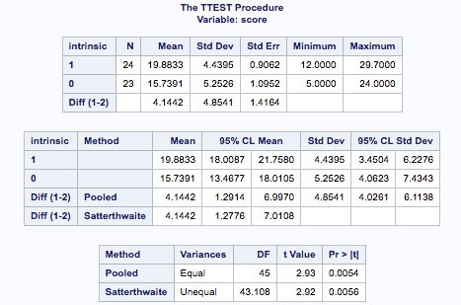

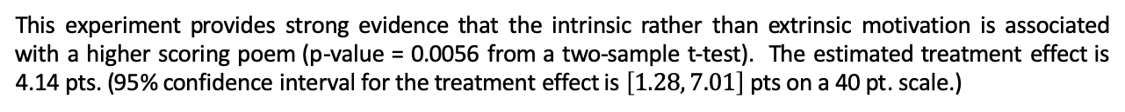
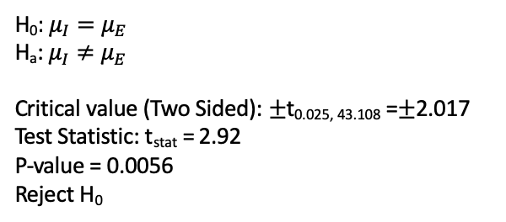
Testing Hypothesis: Welch’s t-Tools
H₀: $μ_{I}=μ_{E}$
H_{a}: $μ_{I}≠μ_{E}$
Critical value (Two Sided): $±$t_{0.025, 43.108} =$±$2.017
Test Statistic: t_{stat} = 2.92
P-value = 0.0056
Reject H₀
This experiment provides strong evidence that the intrinsic rather than extrinsic motivation is associated with a higher scoring poem (p-value = 0.0056 from a two-sample t-test). The estimated treatment effect is 4.14 pts. (95% confidence interval for the treatment effect is $\left[1.28, 7.01\right]$ pts on a 40 pt. scale.)
In R: t.test(Score~Treatment_S, data = Creativity, var.equal=FALSE)

Slide 19
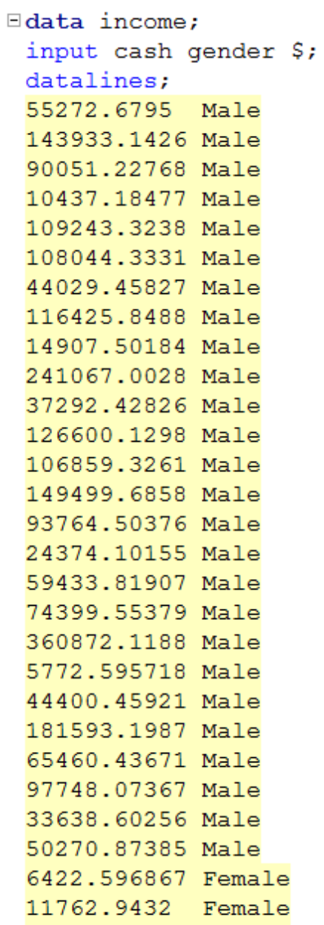
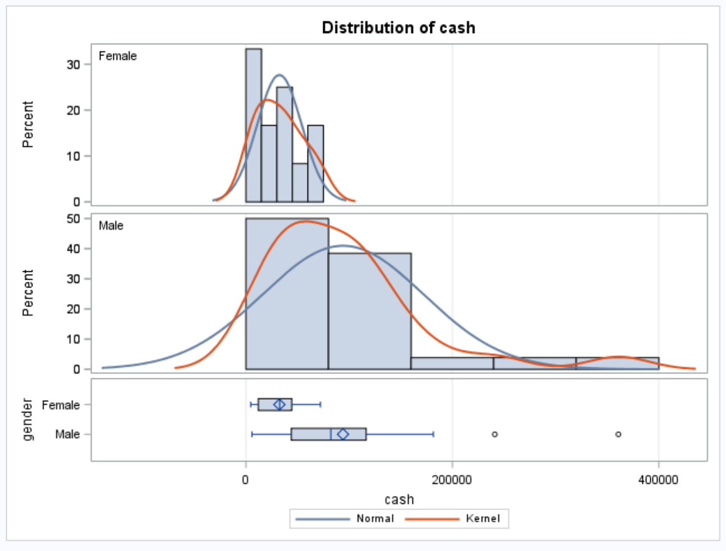
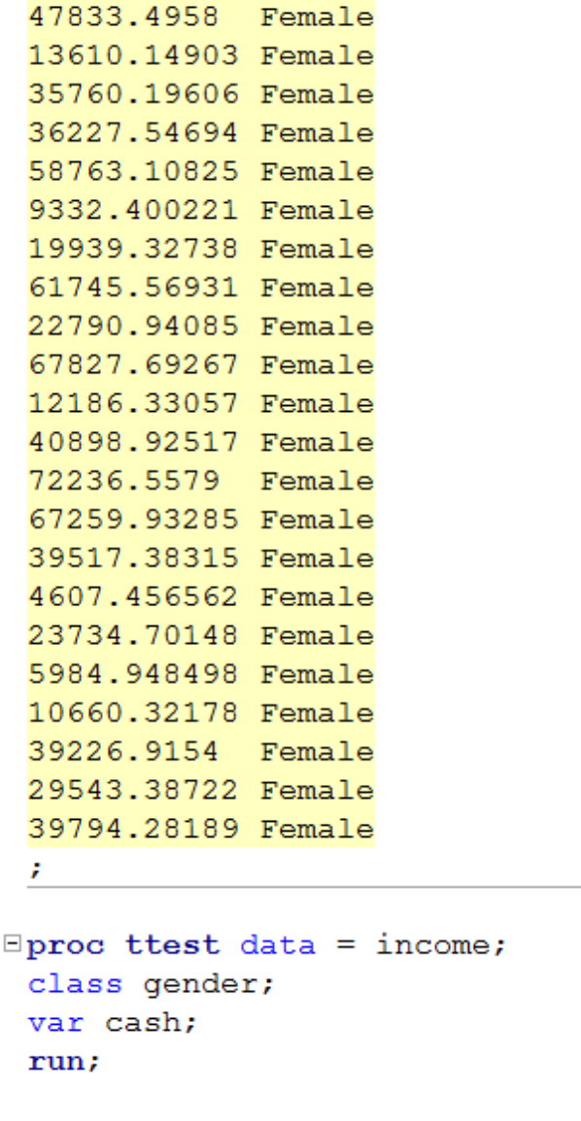
Gender Income Discrimination

Slide 20
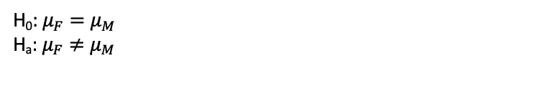
Gender Income Discrimination
H₀: $μ_{F}=μ_{M}$
H_{a}: $μ_{F}≠μ_{M}$
Strong evidence against normality, but CTL applies.
Strong evidence against equal standard deviations and different sample sizes. (They are close but the standard deviations appear to be so different that this may make a real difference.)
We will assume independence.
Student’s t-test not a good idea here.

Slide 21
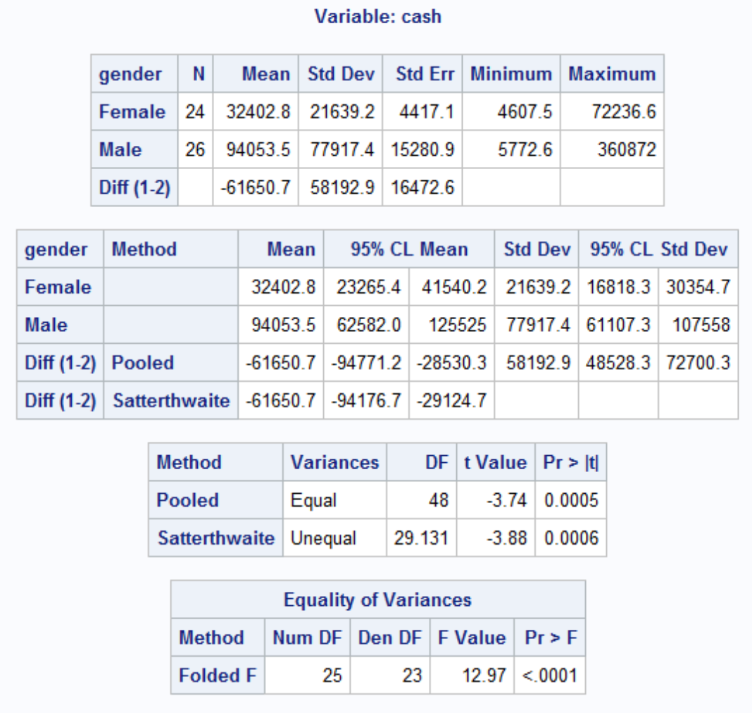
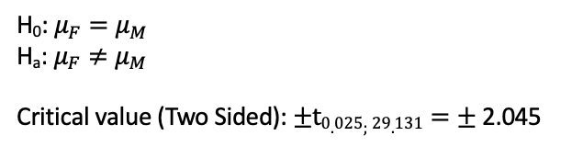
Gender Income Discrimination!
H₀: $μ_{F}=μ_{M}$
H_{a}: $μ_{F}≠μ_{M}$
Critical value (Two Sided): $±t0.025;29.131=±$2.045
Test Statistic: t_{stat} = -3.88
P-value = .0006
Reject H₀
Conclusion: There is strong evidence to suggest that the mean income of the female group is different from the mean income of the male group (p-value = 0.0006). A 95% confidence interval for this difference is ($29,124, $94,176) in favor of the males.
That is quite a difference!

Slide 22
Question 2 (2 hours)
Conduct a Welch’s two-sample t-test on the Education Data from HW 3 (untransformed). Perform a complete analysis using SAS to test the claim that the mean income of college educated people (16 years of education) is greater than the mean of those with a high school education only (12 years of education).
State the problem, address the assumptions. Be sure to support with your knowledge of theory (CLT) as well as with histograms, box plots, q-q plots, etc.
Show all 6 steps, including a thoughtful, thorough, yet non-technical conclusion. Include a confidence interval.
Include a scope of inference at the end. (You may copy and paste this from a previous HW if you like.)
Verify the Welch’s t statistic and p-value with R (using R function t.test). Simply cut and paste your R code and output. You may use: http://rcompanion.org/rcompanion/d_02.html for reference.
Would you prefer to run the log transformed analysis you ran in HW3, or do you feel this analysis is more appropriate? Why or Why not? (Make mention of the assumptions as well as the parameters that each test provides inference on. As you know, they are different.)

Slide 23
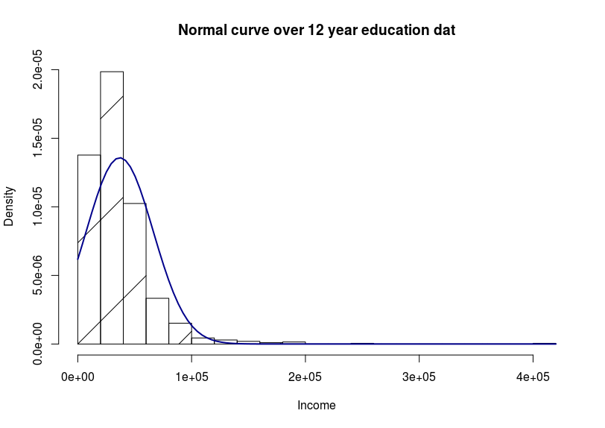
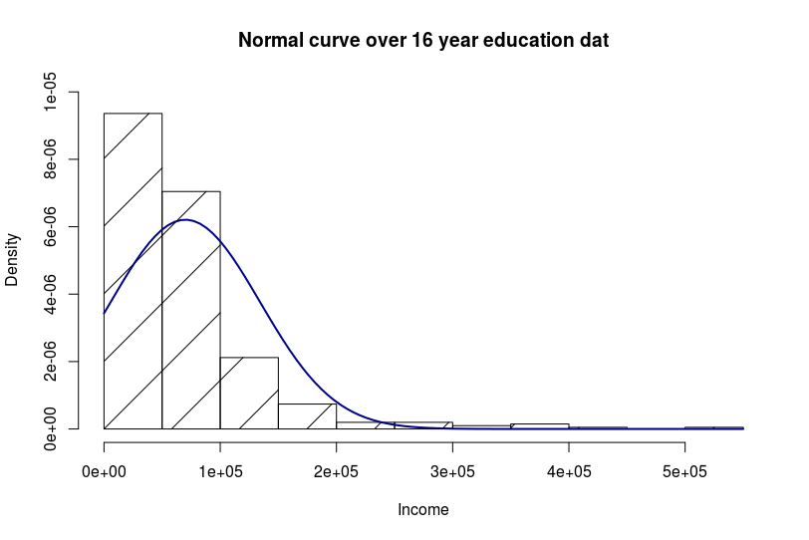
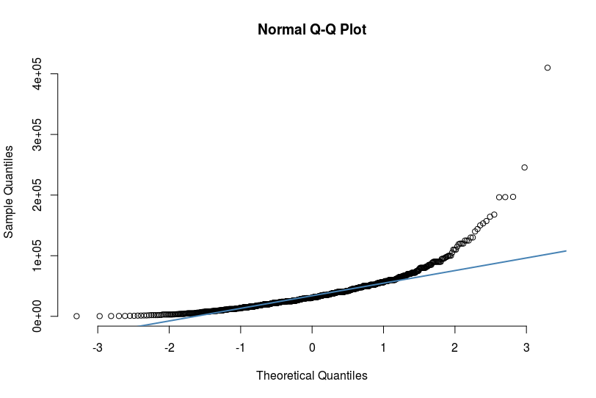
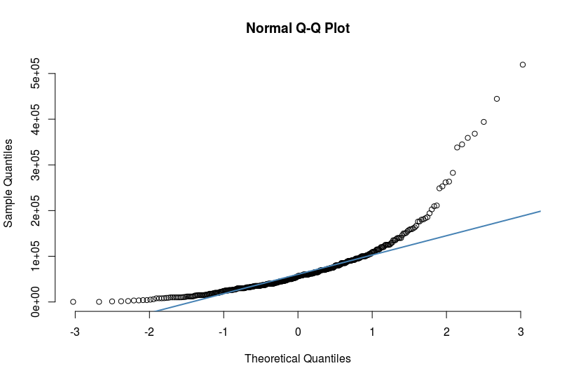
Question 2: Problem Statement and assumptions

Slide 24
Question 2: 6 Steps for Hypothesis Test
Step 1: H_0: Mu_12_income = Mu_16_income
Step 2: H_A: Mu_12_income != Mu_16_income
Step 3: T-Statistic: -7.4721
Step 4: P-Value: P<0.0001
Step 5: Reject H_0!
Step 6: Based on the evidence presented above we have evidence to conclude that there is a difference in the mean income level of those who graduated college and those who did not. Thus, we rejected H_0.

Slide 25
Question 2:Non-technical conclusion and confidence interval
After performing the appropriate statistical test, we can conclude that there is evidence to indicate there is a difference in the mean income level of those who graduated college and those who did not attend college. Our P-value was very significant, and for the most part our model assumptions were met.
A 95% CI for mu: (-13890.852,-8114.071)

Slide 26
Question 2: Scope of Inference
The data is a subset of National Longitudinal Survey of youth (NLSY79).
The question did not indicate random sampling
The sample size is quite large
The subjects were between 41 and 49
I believe this data can be inferred on the population of subjects sampled.

Slide 27
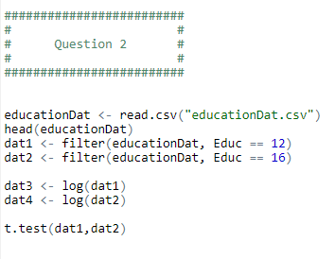
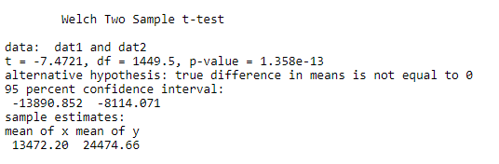
Question 2: Welch Two Sample T-Test in R
R Input/Code:
R Output/Results:

Slide 28
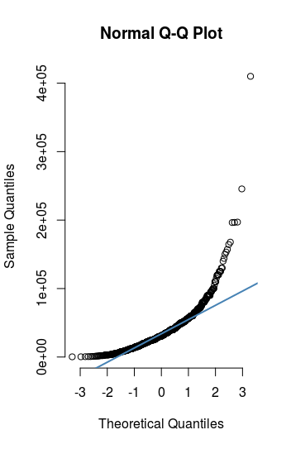
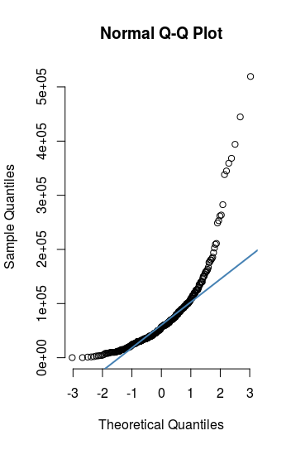
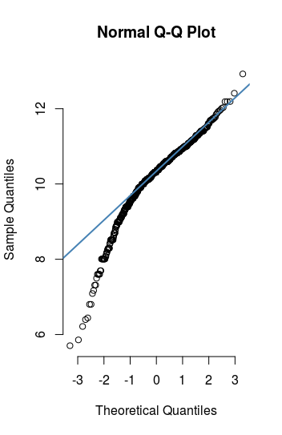
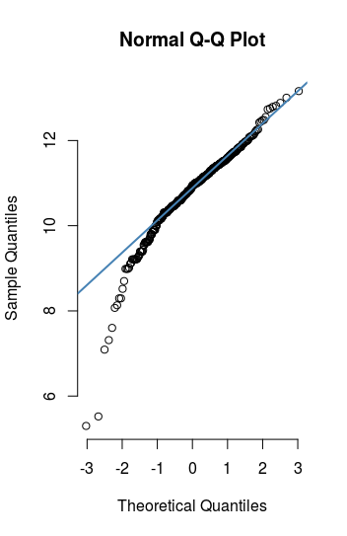
Question 2: Log Transformation
Non-transformed Data:
Transformed Data:

Slide 29
Question 2: Log Transformation
The data in original form is clearly in violation of the T-test assumption of normally distributed data.
QQ-plots verify this assumption violation
After performing a log transformation, we can see that the data is now more normal in it’s distribution.
Log-transforming the data is required in order to perform a valid t-test
Note: The P-value in both the log transformed and original data remains significant. Although the transformed data has a much larger P-value.

Slide 30
End Part 2

Slide 31
End Unit 4 For Live Session Assignment

